Slide 1
AI-ENHANCED ACOUSTIC MONITORING FOR PREDICTIVE RAIL MAINTENANCE AND DEFECT DETECTION
KISHORE KUMAR I
Electronics and Communication Engineering / Third year
R.M.K ENGINEERING COLLEGE

Slide 2
PROPOSED SOLUTION
In the proposed solution ,We are using Acoustic sensors along the rail tracks to continuously collect data.
Real-time preprocessing improves signal quality and extracts waveforms by filtering noise and normalizing data for accurate defect detection.
Advanced ML technique Isolation Forest algorithm is used to find unusual patterns or anomalies in data, helping to detect defects in rail cracks.
The system sends automatic alerts with GPS location details when a crack is detected, and also stores this data in the cloud .
Regular updates and maintenance of the AI models and sensors ensure the system stays accurate and adapts to changing conditions.

Slide 3
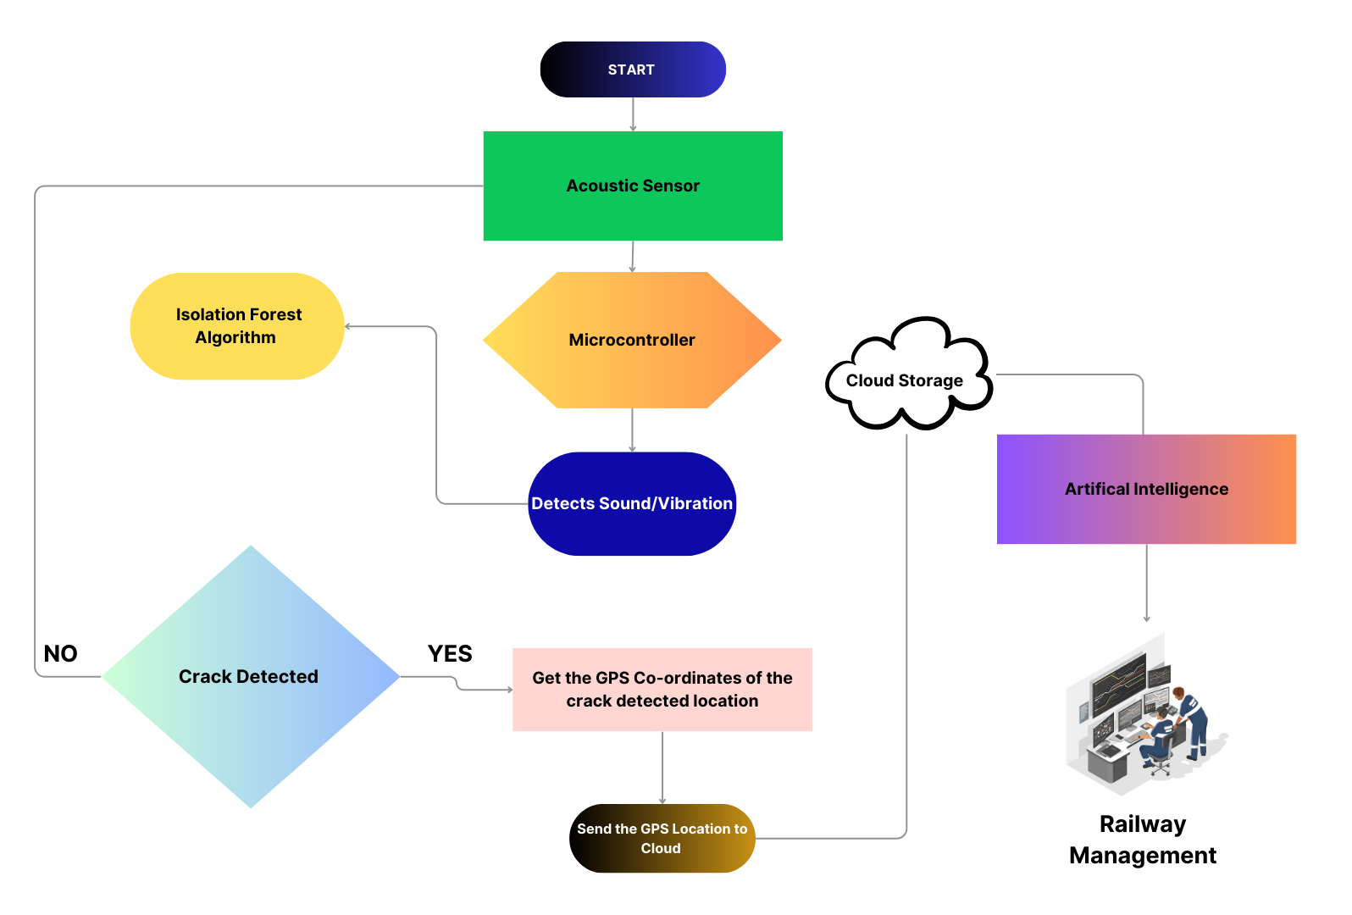
FLOW DIAGRAM

Slide 4

TECHNICAL APPROACH
Modules and Technology Stack :
HARDWARE :
Microcontroller
Sensor Module
A9G Module/GPS Module
A9G GSM/GPS Module
SOFTWARE :
Machine learning algorithm - Isolation Forest
Cloud Storage - Adafruit IO
Libraries – scikit-learn library

Slide 5
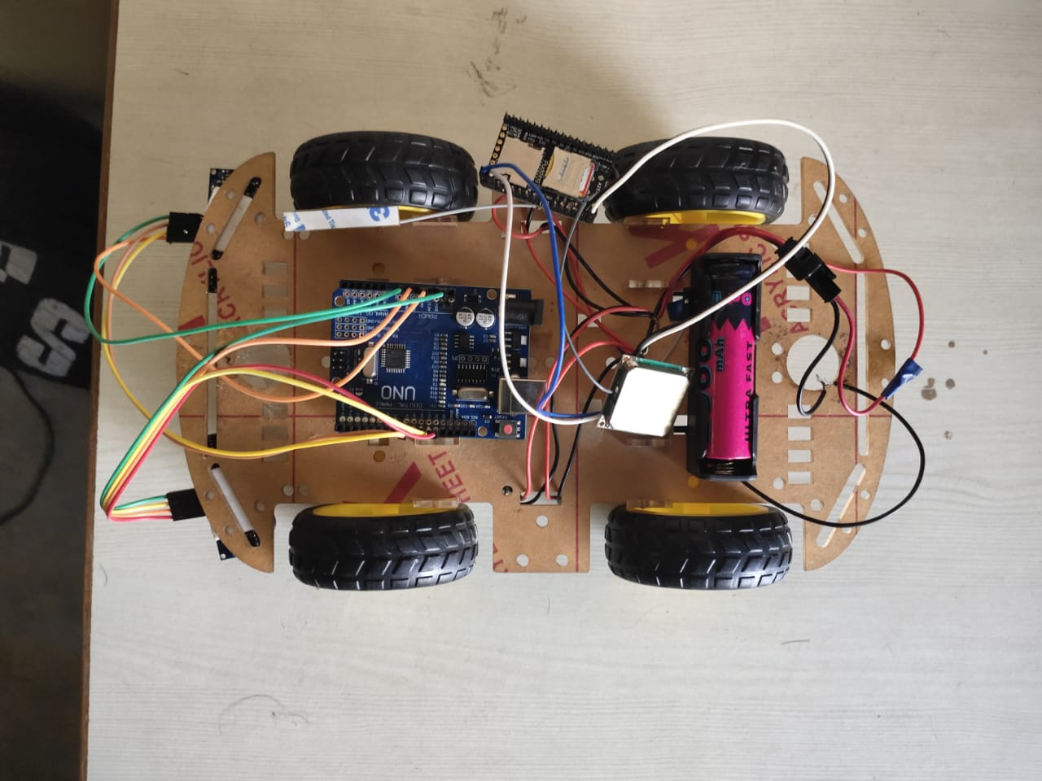
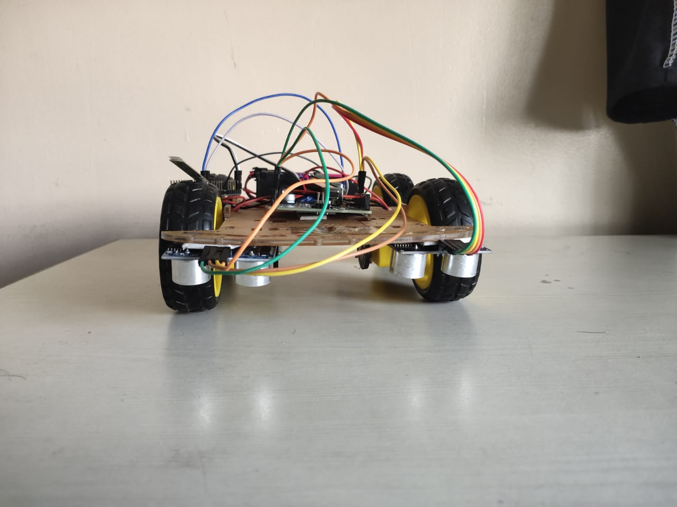
PROTOTYPE

Slide 6
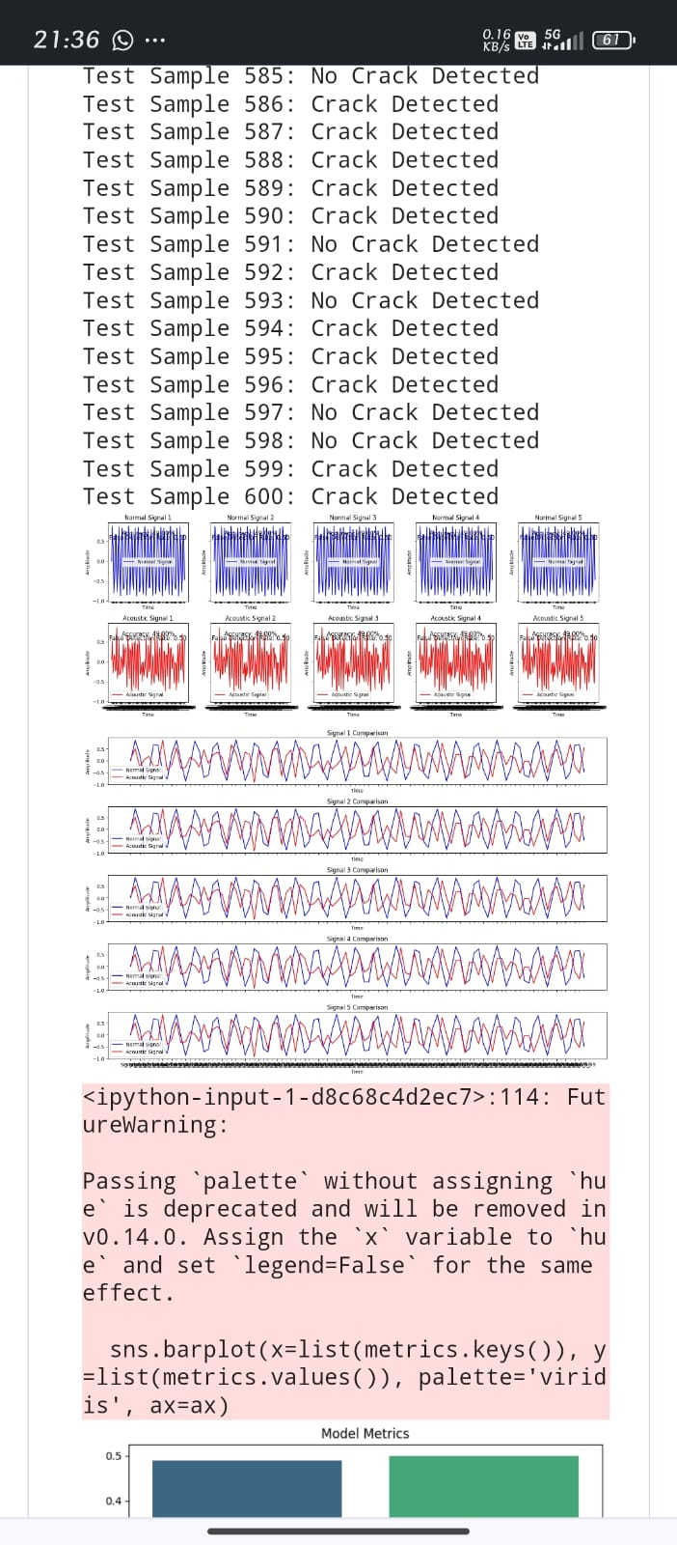
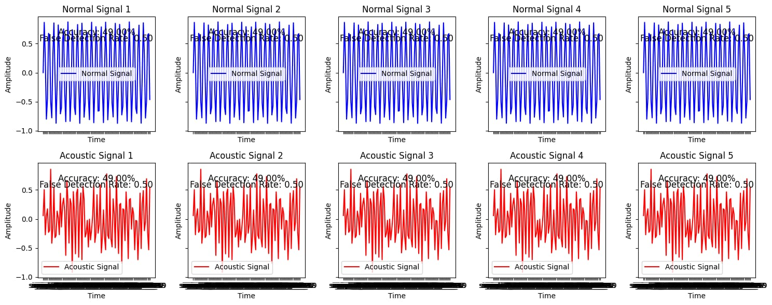
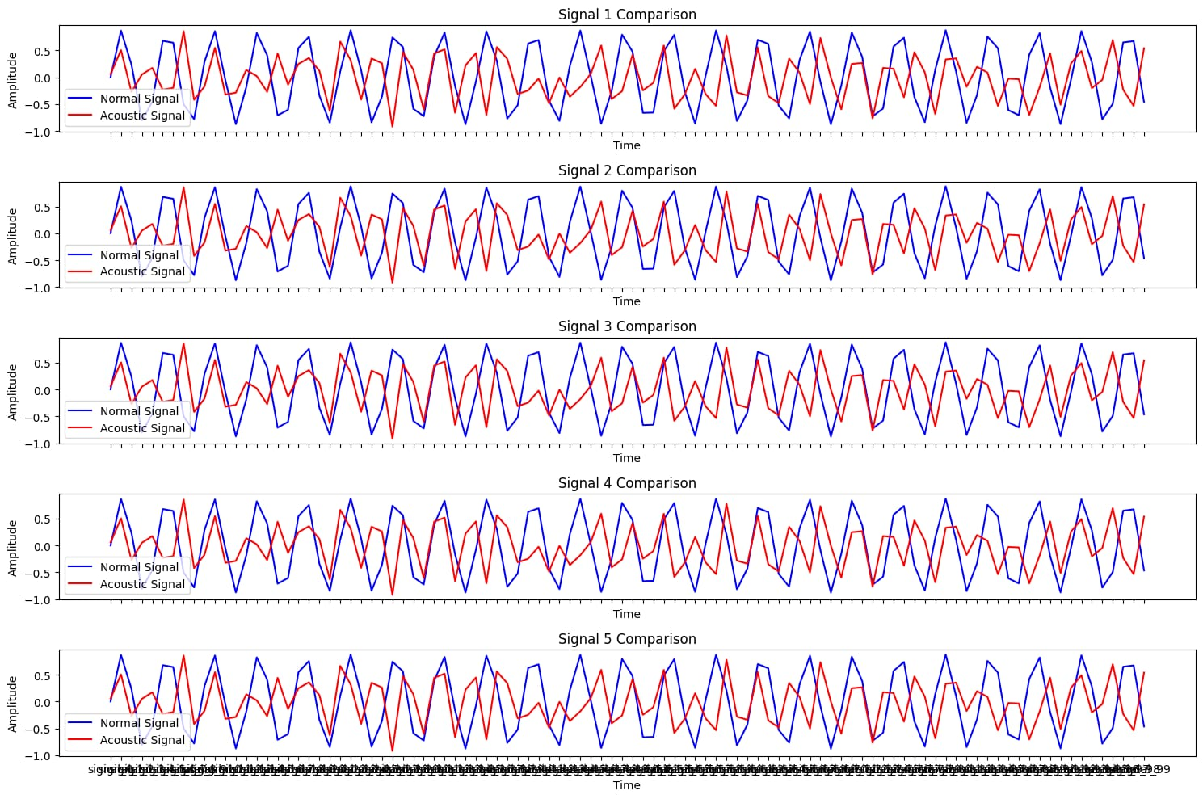
RESULT OBTAINED BY USING SENSORS AND ML TECHNIQE

Slide 7
FEASIBILITY AND VIABILITY
FEASIBILITY
Sensor Technology
Cloud Storage
AI/ML Models
System Integration
Scalability
VIABILITY
Cost Efficient
Accuracy and Reliability
Enhanced Safety
Adaptable System
Flexible
Growing Demand

Slide 8
IMPACT AND BENEFITS
Increased Safety: Early detection of track defects reduces accident risks, ensuring the safety of passengers and railway staff.
High Efficiency: Proactive issue identification minimizes downtime, keeping trains running smoothly and improving operational efficiency.
Cost Reduction: Addressing minor defects before they escalate saves on repair costs and avoids expensive disruptions.
Extended Track Life: Regular monitoring and timely repairs help extend the lifespan of rail infrastructure.
Enhanced Reliability: Fewer unexpected failures lead to more reliable and consistent rail service.

Slide 9
FUTURE ENHANCEMENT
In future developments, laser Edging could enhance rail maintenance by detecting and marking cracks with precision. When a crack is found, the system would use a laser to highlight its exact location on the track. This visible mark would help maintenance crews quickly locate and fix the issue, leading to faster repairs and improves safety.

Slide 10
RESEARCH AND REFERENCES
,
,
,
“A Novel Approach to Railway Track Faults Detection Using Acoustic Analysis” By Dr. Saleem Ullah , Rahman Shafique and Furqan Rustam (2021).
“Crack Detection System for Railway Tracks by Using Acoustic Emission Sensor” By R. Swetha and S. Kayalvizhi (2017).
“A Machine Learning-Based Approach for Fault Detection of Railway Track and its Components” By Johnny Asber (2020).
“An initial investigation on the potential applicability of Acoustic Emission using ML techniques to rail track fault detection” By Kristoffer Bruzelius and D Mba (2014).

